Slide 1
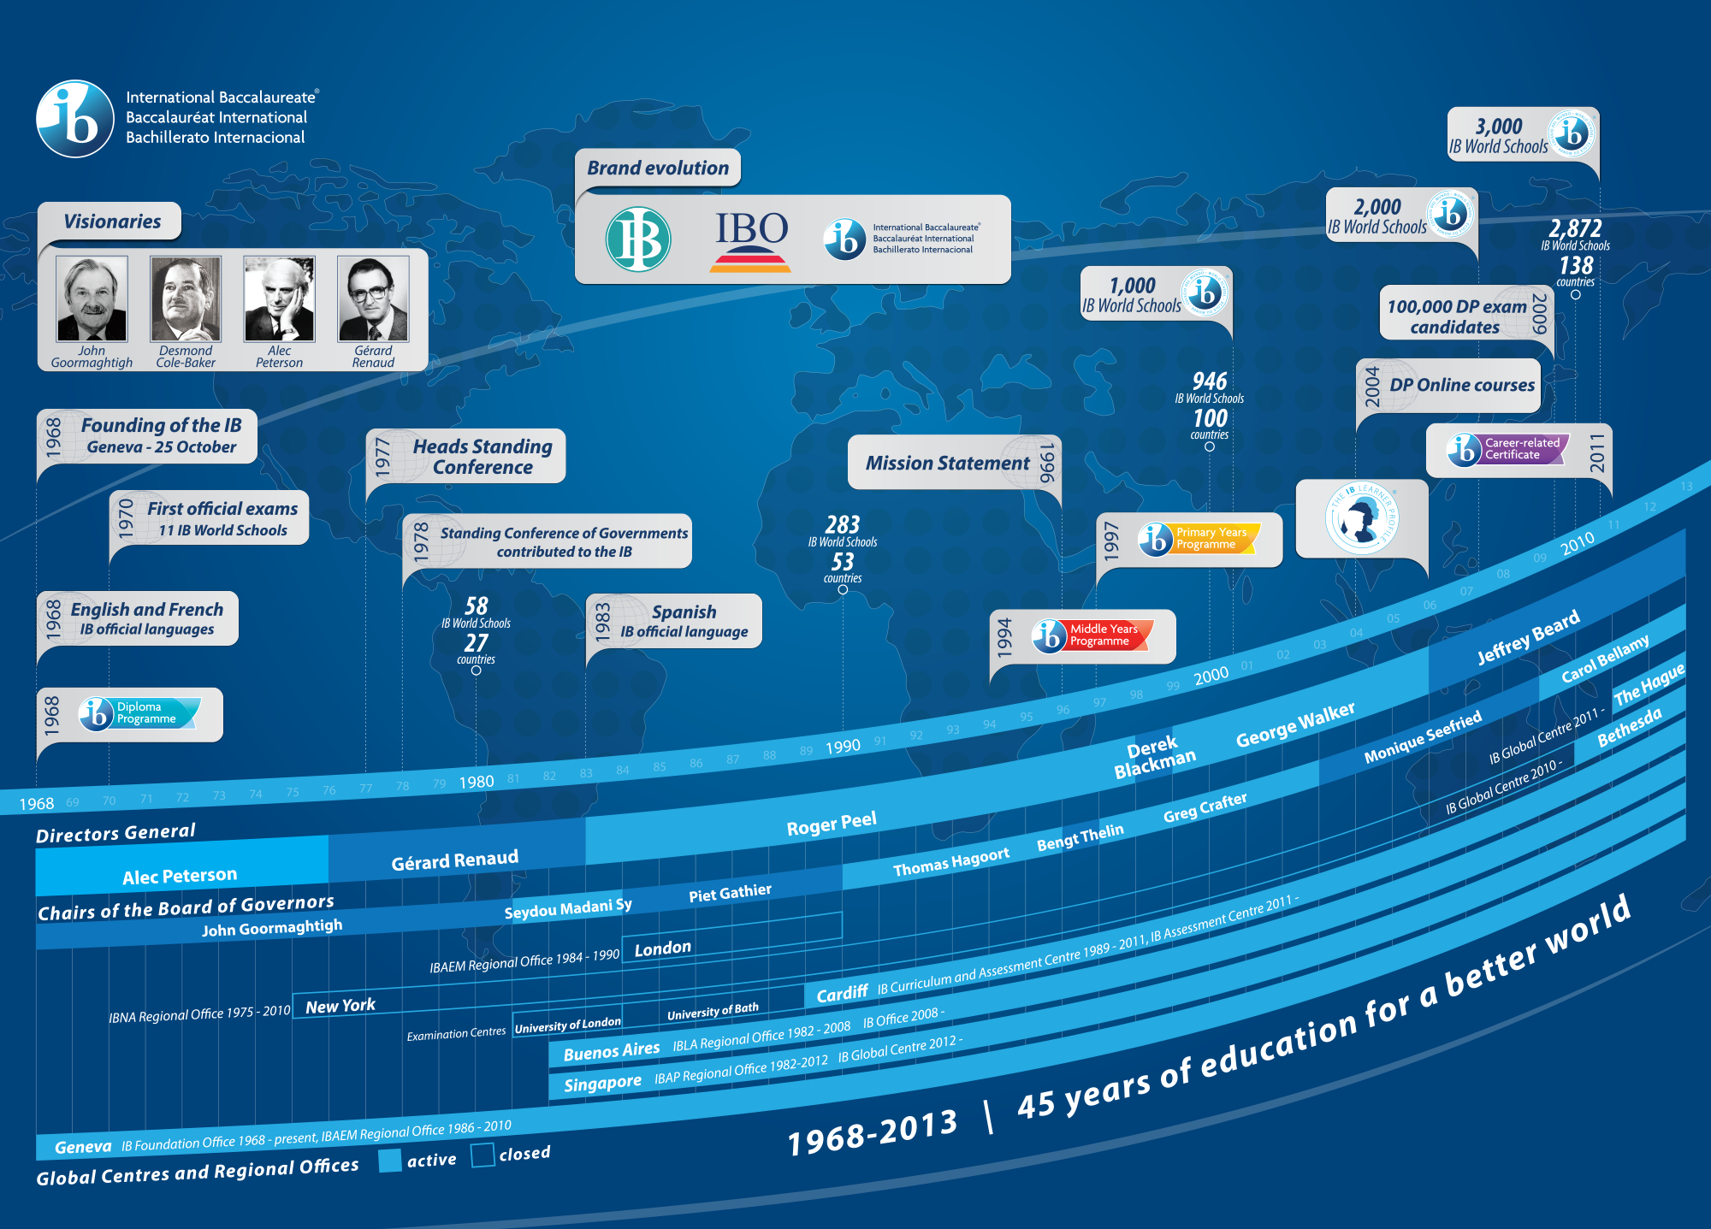
Notes:
We can give kind of a mini-lecture

Slide 2
“Big Ideas” of PYP
Promotes international-mindedness
Based on constructivist theory
Concept-based curriculum
Balances transdisciplinary inquiry with traditional disciplines.
Balance between the acquisition of skills, knowledge and meaning.
Authentic assessment (valid and varied) .
Inquiry as a predominant but not exclusive pedagogical tool.
Collaboration

Slide 3

What is the IB mission?
The International Baccalaureate aims to develop inquiring, knowledgeable and caring young people who help to create a better and more peaceful world through intercultural understanding and respect.
To this end, the IB works with schools, governments and international organizations to develop challenging programmes of international education and rigorous assessment.
These programmes encourage students across the world to become active, compassionate and lifelong learners who understand that other people, with their differences, can also be right.

Slide 4
Caring
Thinker
Risk-Taker
Knowledgeable
Inquirer
Open-Minded
Balanced
Communicator
Reflective
Learner Profile
Principled
Curriculum
Everything for which the school takes responsibility
International School
culture, climate, students example of adults, curriculum, resources, staffing, language, special needs, reflection,extension
Learners Constructing Meaning
Concepts
Form
Function
Causation
Change
Connection
Perspective
Responsibility
Reflection
Knowledge
Who We Are
Where We Are in Place
and Time
How We Express
Ourselves
How the World Works
How We Organize
Ourselves
Sharing the Planet
Transdisciplinary
Skills
Social
Communication
Research
Thinking
Self-Management
Attitudes
Appreciation
Commitment
Confidence
Co-operation
Creativity
Curiosity
Empathy
Enthusiasm
Independence
Integrity
Respect
Tolerance
Action
Choose
Act
Reflect
Practice
Effective
Teaching
Inquiry
Constructivism
Collaborative
Planning
Collaborative
Reflection
Assessment
Self
Peers
Teachers
Formative
Summative
Formal
Informal
Public
Criteria
Written Curriculum
Five Essential Elements of the PYP
Taught
Curriculum
Assessed
Curriculum

Slide 5
Let’s take a quick look at the standards put forth by IB
Standard A: PHILOSOPHY
  The school’s philosophy matches that of IB and the school is committed to developing internationally-minded students
Standard B: ORGANIZATION
  The school has put structures in place to make IB work (financial backing, staff, resources)
Notes:
4

Slide 6
Standard C: CURRICULUM
  A well-balanced POI exists, collaboration is taking place among teachers, teaching methods build lifelong learners, assessment methods are agreed upon and shared with all members of the school community.
Notes:
5

Slide 7
A Global Future
The IB mission statement speaks of preparing learners for a global tomorrow.
INDEPENDENTLY
What is the world that they are facing like?
What will they need to know?
COLLABORATIVELY
What does this mean for the students we are charged with teaching today?
How will we prepare them to be global citizens?
Let’s explore….
Notes:
Independent, collaborate, share out

Slide 8
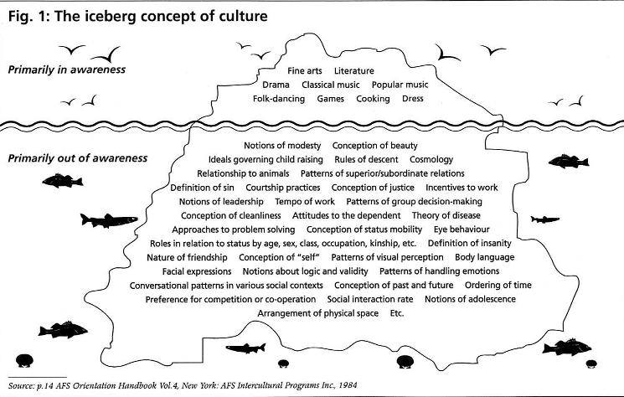

Slide 9

What is the Learner Profile?
The attributes of the learner profile express the values inherent to the IB continuum of international education: these are values that should infuse all elements of the three programmes and, therefore, the culture of all IB World Schools.
IB programmes promote the education of the whole person, emphasizing intellectual, personal, emotional and social growth through all domains of knowledge.
IB learners strive to be:
Inquirers
Knowledgeable
Thinkers
Communicators
Principled
Open-minded
Caring
Risk-takers
Balanced
Reflective
Notes:
8
8

Slide 10
And… let’s further our learning…
Connect-Extend-Challenge
How are the ideas and information presented connected to what you know and
have studied?
What new ideas extended or pushed your thinking in new directions?
What is still challenging or confusing for you? What questions, wonderings, or
puzzles do you have?

Slide 11
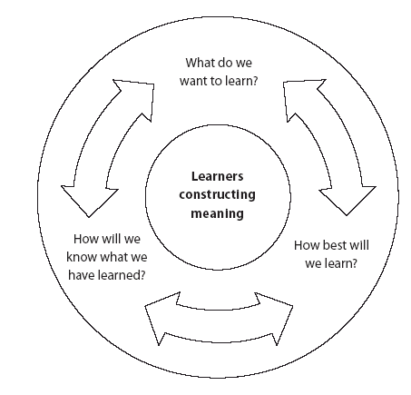
The PYP Curriculum Model
The PYP structures its curriculum model using three interrelated questions.
What do we want to learn?
The written curriculum
the identification of a framework of what’s worth knowing
How best will we learn?
The taught curriculum
the theory and application of good classroom practice
How will we know what we have learned?
The assessed curriculum
the theory and application of effective assessment
From: MTPYPH p 9

Slide 12
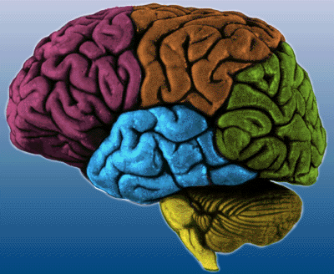
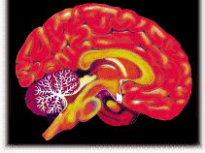
Traditional Classroom Methodology
Teacher Students
Enduring Understanding:
At the heart of the curriculum cycle is the learner constructing meaning.

Slide 13
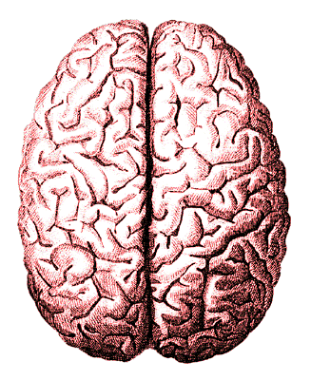
Constructivist Theory / Methodologies
Enduring Understanding:
At the heart of the curriculum cycle is the learner constructing meaning.

Slide 14
The PYP Curriculum Model
What do
we want
to learn?
WRITTEN CURRICULUM
Learner Profile
Essential Elements (Concepts, Knowledge, Skills, Attitude and Action)
Learners
Constructing
Meaning
How will we
know what
we have
learned?
How best
will we
learn?
© IBO 2003
Notes:
13
PYP defines curriculum for which the school is responsible( written, taught, assessed – the interdependent components form a balanced curriculum
Arrows going both ways (p9 MPYPH)
Give examples of written curriculum documents-state standards, assessments-state tests NCLB, already in place and the taught curriculum were the examples they gave internationalism should be embedded
LUNCH 12:15 – 1:00 sit in grade level

Slide 15
The PYP essential elements:
What makes up the curriculum model?
The Essential Elements of the Written Curriculum:
Knowledge – What do we want our children to know and explore?
Skills – What do we want our children to be able to do?
Concepts – What do we want our children to be able to understand?
Attitudes – How do we want our children to feel?
Action – How will the children demonstrate what they have learned?
Notes:
14

Slide 16
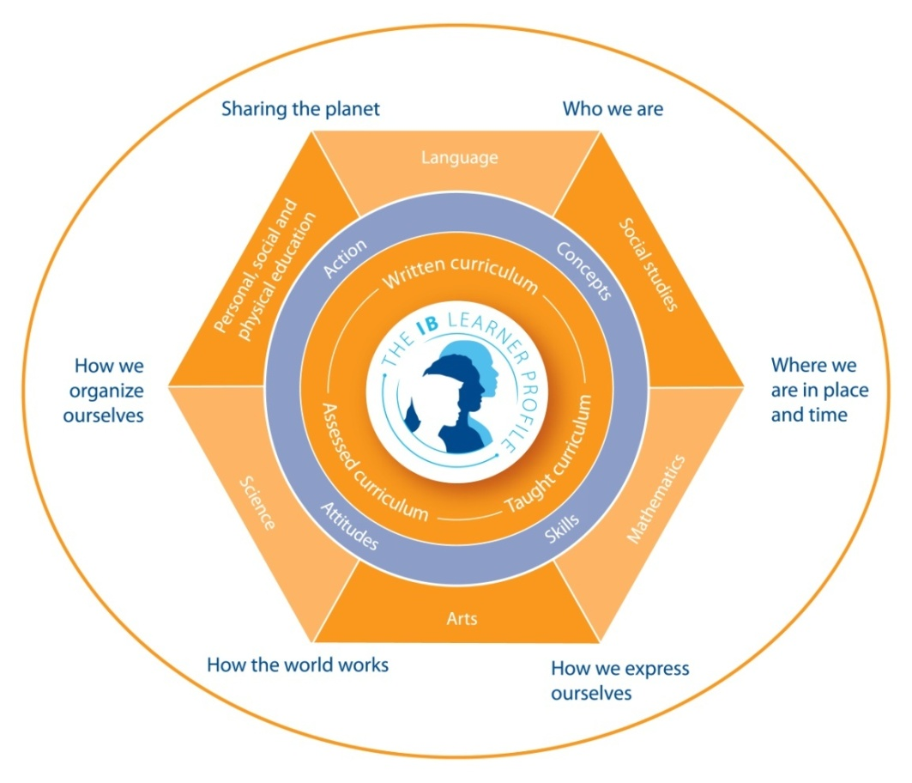
Each International Baccalaureate (IB)
Primary Years Programme (PYP) develops a Programme of Inquiry which revolves around six transdisciplinary themes.
“Students inquire into, and learn about, these globally significant issues in the context of units of inquiry, each of which addresses a central idea relevant to a particular transdisciplinary theme.”
Making the PYP Happen, pg. 12

Slide 17

Taking a Closer Look at the Programme of Inquiry
Review the PoI for BALANCE
  Repetitions
  Holes – What’s missing?
  Science / Social Studies
  State Standards / Core
  Transdisciplinary Theme descriptors – pg.12

Slide 18
Key Concepts in the PYP
Form – What is it like?
Function – How does it work?
Causation – Why is it like it is?
Change – How is it changing?
Connection – How is it connected to other things?
Perspective – What are the points of view?
Responsibility – What is our responsibility?
Reflection – How do we know?
Notes:
17

Slide 19
Concepts
What do we want students to understand?
“A universal concept is a mental construct that is timeless, universal and abstract” (Erickson).
Science Order Organism Population System Change Evolution Cycle Interaction Energy/matter | Social Studies Conflicts Patterns Populations System Change/continuity Culture Evolution Civilization

Slide 20
Concept vs. Topic
Concept | Topic
are learned in the context of a "bigger picture or idea" | are often performance-based activities learned in isolation
more focus on teaching principles and generalizations | more focus on teaching facts and dates
transfer through time and across cultures and transcend singular examples | are focused on a single event at a single time
students are asked to develop a deeper understanding | students are asked to memorize
provide multiple entry points for students interest and learning styles | narrow focus leaves students with few ways to interact with material
create integrated thinking which operates on a conceptual level | unconnected information that is learned on a factual level
“Conflict during civil wars” | "The American Civil War"

Slide 21
Moving from topic to concept…
An example:
  If the state curriculum dictates that fifth graders learn about the Revolutionary and Civil Wars, perhaps creating a planner about fear and safety would be prudent.
  At once you have both broadened the concept to be more universally applicable, and you have narrowed the focus with which you approach the vast possibilities of teaching American history.
  Transdisciplinary opportunities for study present themselves with a broadened concept. (Neural systems, responses to fear, interviewing skills, data collection, personal narratives, etc.)
  Students can make personal connections to the concept and therefore relate to and remember the curriculum.
  The concepts of fear and safety are engaging, relevant, significant and challenging. Exploring these concepts in depth is likely to lead to student action.

Slide 22
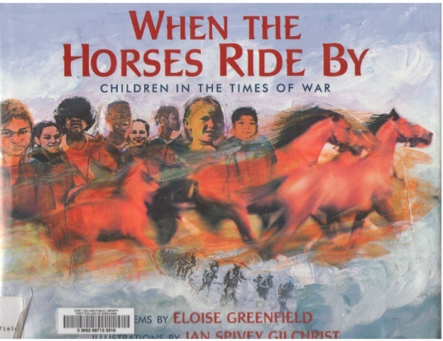
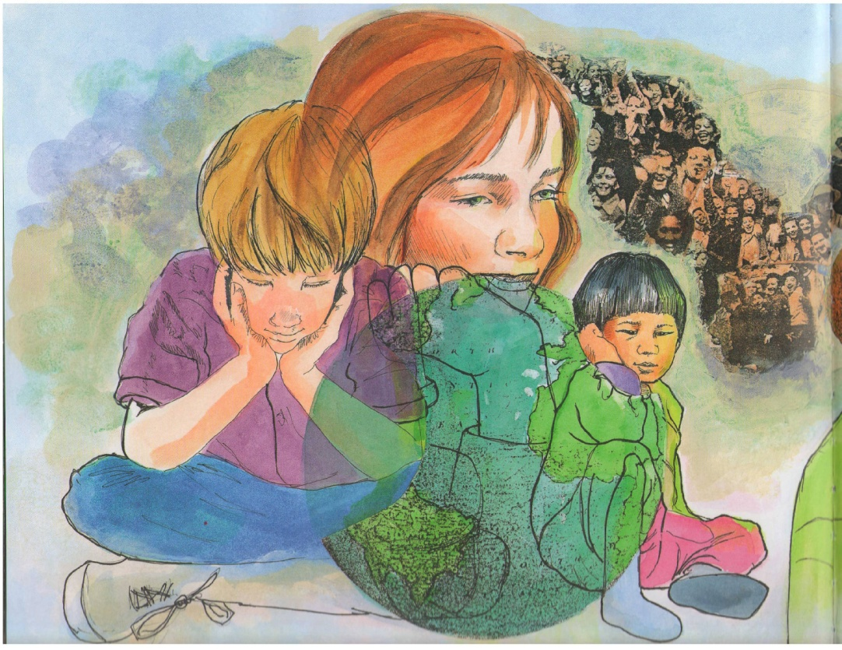


Slide 23
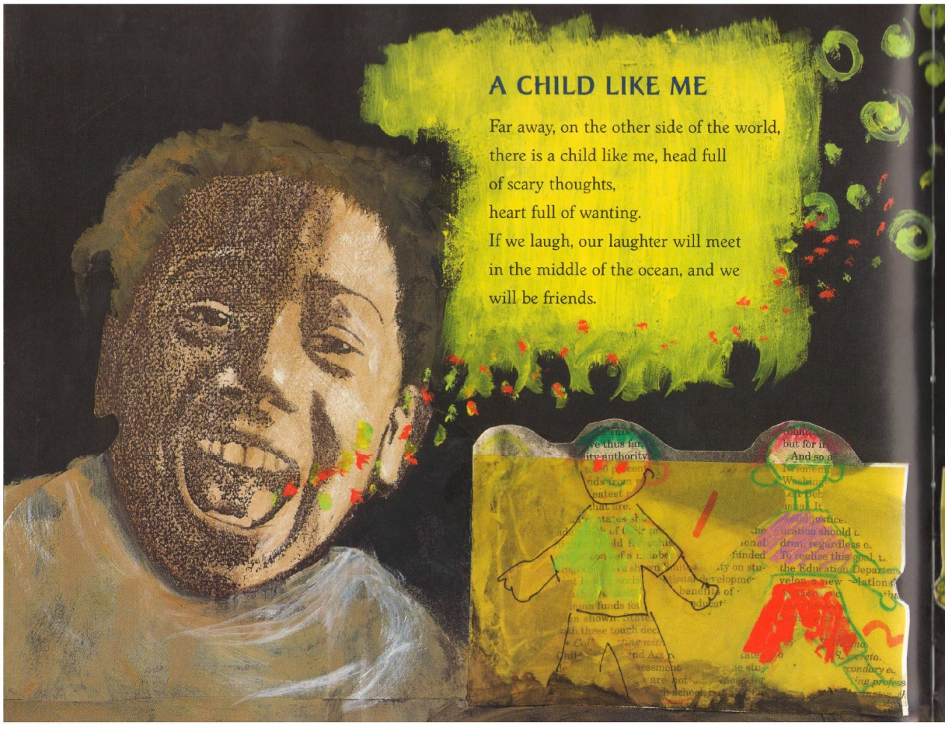
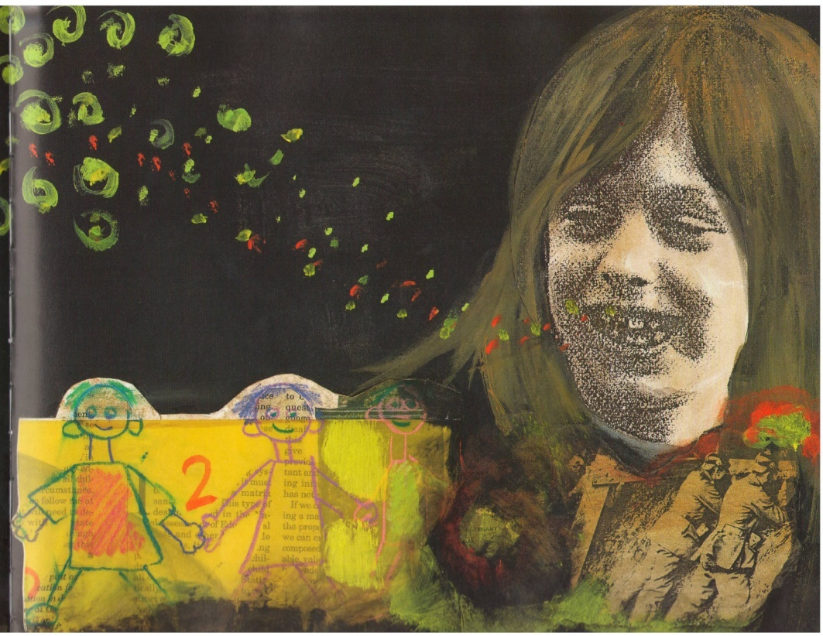

Slide 24
REFLECTION:
How we come to know
about your topic
FORM:
What your topic
is like
FUNCTION:
How your topic
works
RESPONSIBILITY:
What our
responsibility
towards your
topic is
CAUSATION:
Why your topic
is the way it
is
Your Topic Here
PERSPECTIVE:
What the points
of view or opinions
are about
your topic
CHANGE:
How your topic
has changed or
is changing.
CONNECTION:
How your topic is
connected to
other things
Notes:
23

Slide 25
generalization
broad/ abstract
universal
timeless
true
present tense verb
Central Idea
e.g. Living organisms have adapted over time to survive in their habitat.
abstract
universal
timeless
1 or 2 words
Concepts
e.g. Time, Change, Adaptation
Topic
Topic
specific
Standards?
e.g. Animals, Habitats
e.g. Seals live in cold ocean water.
Fact
Fact
Fact
Fact
Fact
Fact
Notes:
24
Facts vs topics vs concepts vs enduring understandings
central idea criteria in bubble
Break – 20 MIN
BUBBLE PLANNER SECTION 5 P37 - unit planners are used to document the 6 units of inquiry at grade levels. everyone involved in teaching students should be involved in the process of creating the units. It is not solely the job of the homeroom teacher. This is a collaborative process.
Share models of collaboration (personal experiences in schools)– no one way to make it work – schools need to devise methods and schedule that allow for collaboration

Slide 26
How to write a central idea…. POLICY
The central idea should:
be written in one sentence
concisely express an enduring understanding
be substantial enough to generate in-depth inquiries
be concept driven
promote the ability to think critically
challenge and extend students’ prior knowledge
be a means of extending students’ understanding of the transdisciplinary theme
from bubble planner MTPYPH p 37

Slide 27
Helpful Hints:
A central idea…….
determines the overall theme of a unit
is written as a broad statement
is clear and concise
is worth knowing
is true/valid
is not value laden
is globally transportable
can be studied at any age
has a degree of complexity
has a degree of ambiguity that promotes ‘uncoverage’/discovery
no proper nouns
written in present tense
developed/adapted by Ellen Alquist, Ann Hickey, Jim Mahoney , Lynn Erickson

Slide 28
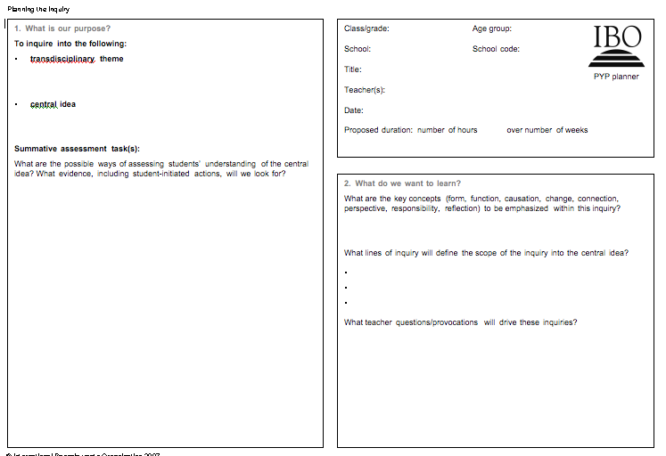
The PYP Planner
The teacher’s planning tool for the unit of inquiry.
Teachers collaborate on planning together across grade levels.
Teachers plan together at each grade level.
This is your primary planning, teaching and assessment guide for each unit.

Slide 29
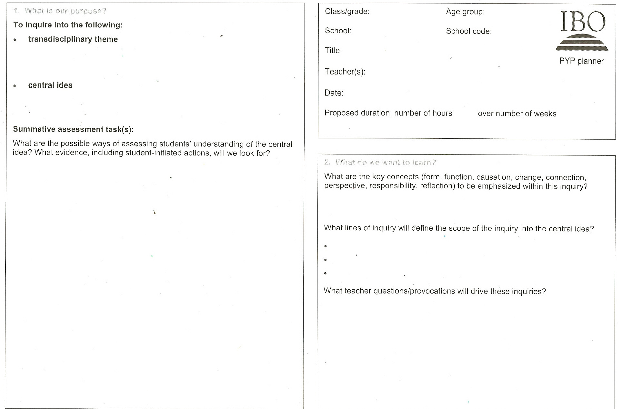
Central Idea

Slide 30
Let’s check out a few Central Ideas…
A community is impacted by the involvement of its members.
Signs and symbols can be used to communicate a message.
People develop systems to forge a functioning society.
Social justice emerges from open-minded consideration and responsible action.

Slide 31
The Lines of Inquiry should…
illuminate the central idea
relate directly to the central idea
have no more than 3-5 points
show a breakdown of the big picture
facilitate teachers’ questions
reflect scope and sequence
develop concrete connections to the central idea

Slide 32
Lines of Inquiry

Slide 33
Let’s check out a few lines of inquiry…
Central Idea: A community is impacted by the involvement of its members.
Students roles and contributions in the home, school, and other environments
The process of decision making
Understanding and meeting the needs of the community

Slide 34
Stages in Backward Design
Identify desired results
Determine acceptable evidence
Plan learning experiences and instruction
Notes:
33

Slide 35
Assessment
When the chef tastes the soup it is formative
When the guest tastes the soup it is summative

Slide 36

A closer look at assessment and the PYP
Jigsaw Reading
Pg. 44:Everyone reads
Pgs. 45-47: Read your Puzzle Piece

Slide 37
When planning for assessment, it is important to ask these questions:
What is the function of the assessment?
What central idea or learning objectives are being assessed?
What evidence of learning will be looked for?
What experiences are being provided/supported to help students be successful with the assessment?
Will the assessment task demonstrate understanding?
Is the assessment reliable enough to allow sound conclusions to be drawn?
How and when will feedback be given?

Slide 38
Summative Assessment

Slide 39
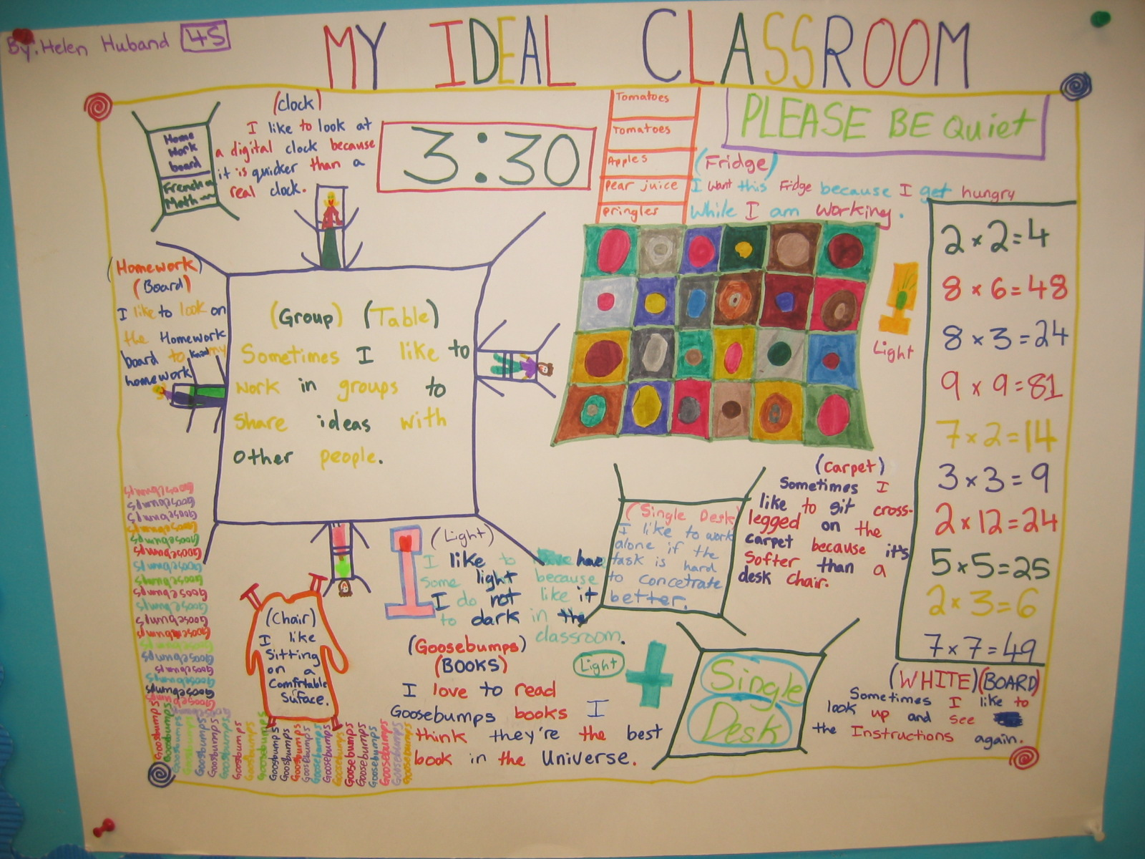
Notes:
38
A summative assessment of a grade four unit under ‘Who We Are’ as students explored different learning styles and identified their own.

Slide 40
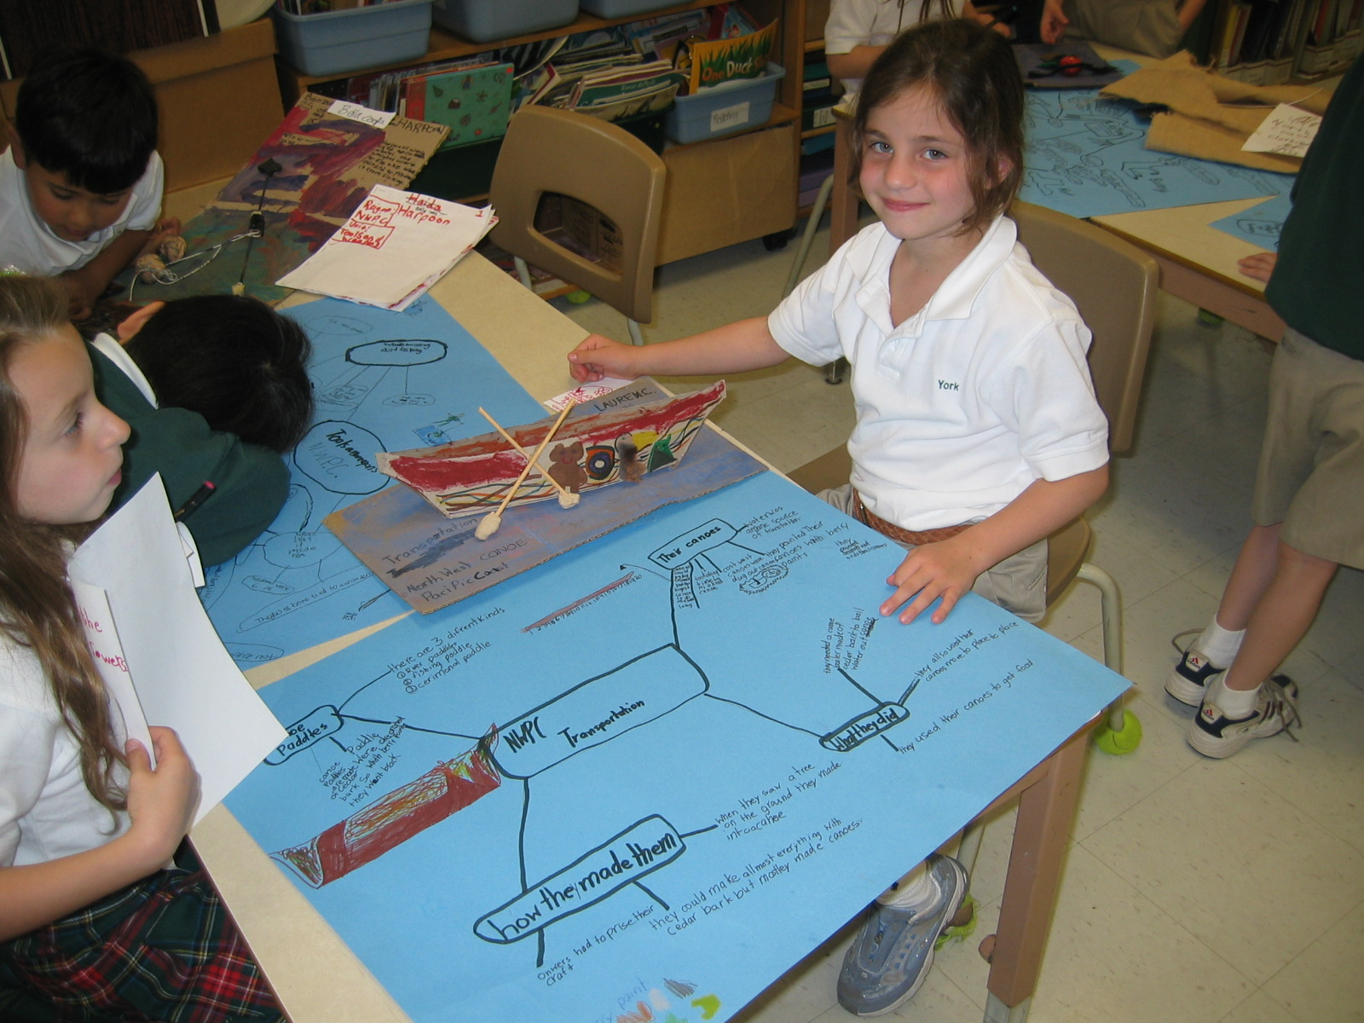
Notes:
39
Grade 2 student creating a graphic organizer and artifact to make a presentation about various methods of transportation used by Iroquois, Blackfoot and Haida.

Slide 41
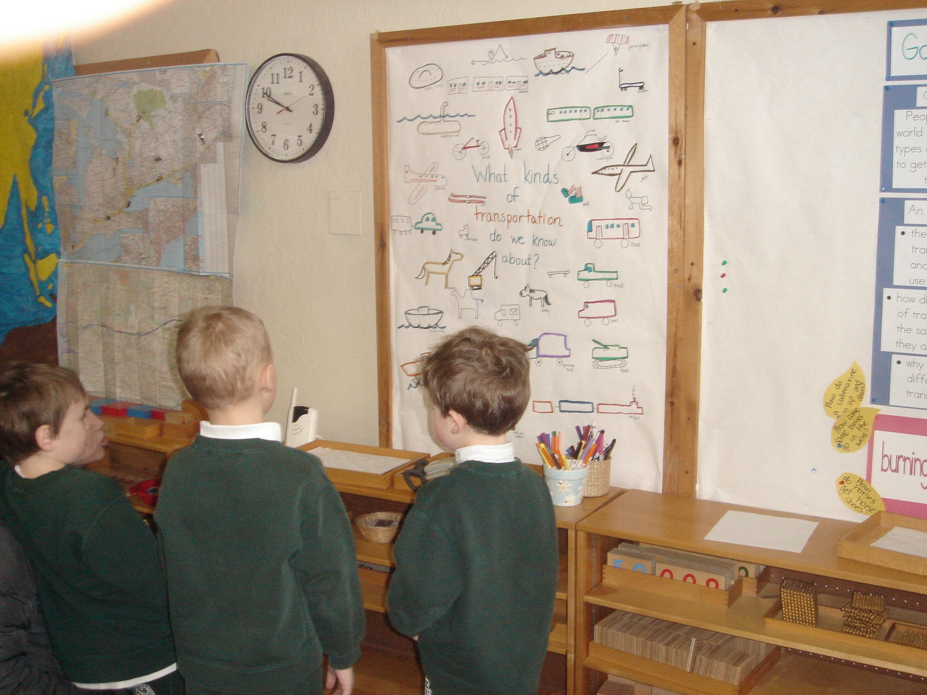
Notes:
40
Kindergarten boys discussing their pre-unit brainstorming

Slide 42
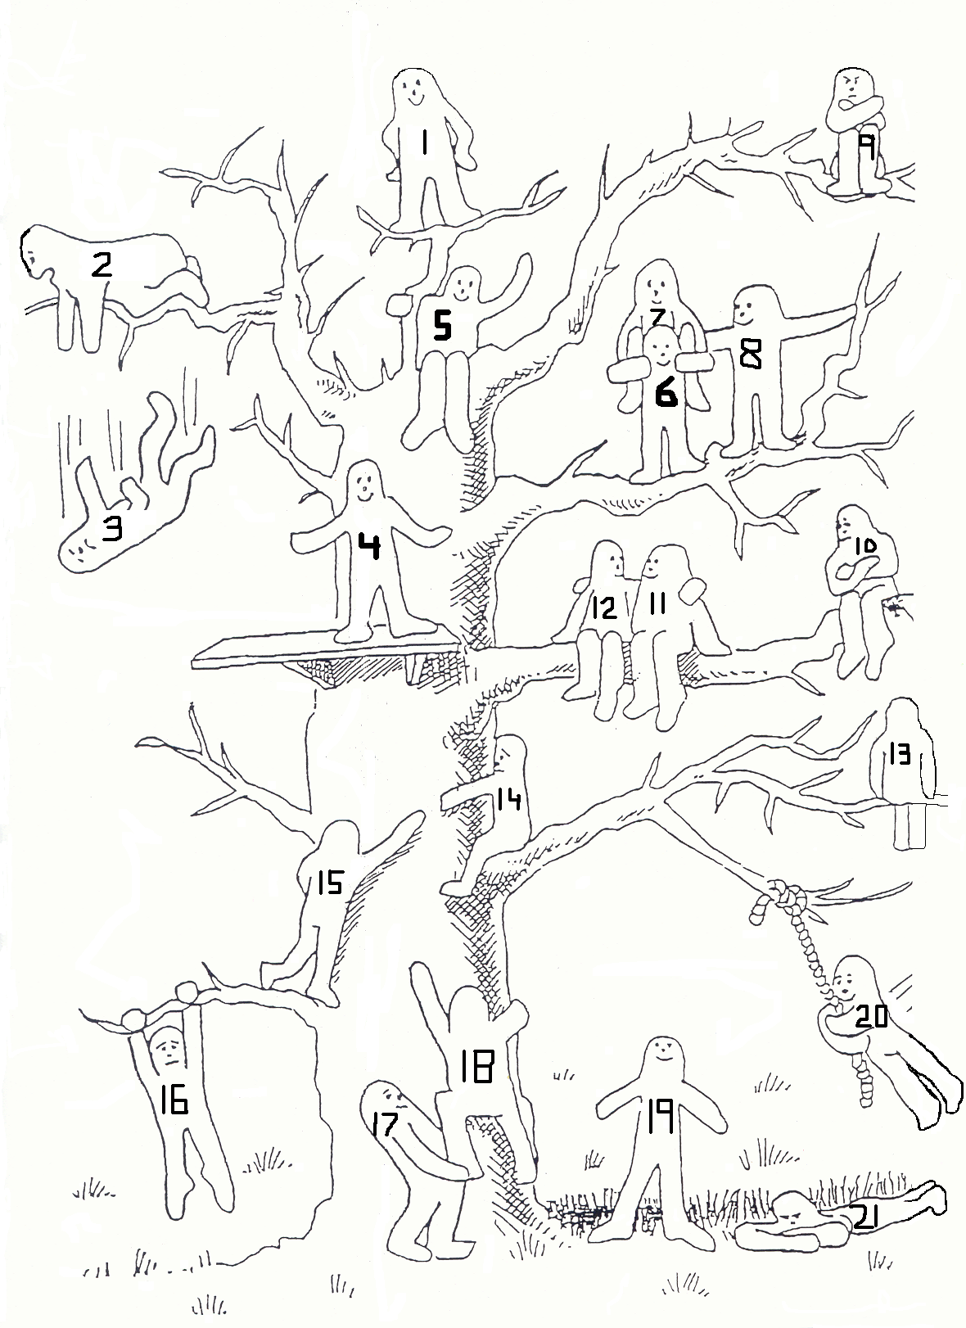
Where are you?
Why?
Turn and talk

Slide 43
What is the teacher doing during inquiry focused events?
Listening
Participating
Coaching
Articulating children’s implied connections
Inviting children to elaborate
Scaffolding
Provoking
Recording
Guiding
Negotiating power
Notes:
42

Slide 44
What does inquiry sound like?
Help me understand...
Tell me more...
I wonder if...
That surprises you...
So you think maybe...
What do you think...
In what ways do you know...
There’s a part I want to ask...
I'm trying to figure out...
I wonder why...
Well maybe...
I think that...
I noticed...
This is what I don't get...
It makes sense that...
I thought it was...
Notes:
43

Slide 45
The role of the Teacher:
To provide “frontloading” when necessary
To provide opportunities for exploration and independent learning, facilitating rather than teaching directly when appropriate
To set the environment for students being responsible for their own learning
To provide resources, including time for student exploration and reflection
To question appropriately to lead to greater student understanding
Notes:
44
2:20/ Break 10 min

Slide 46
What does IB say about inquiry?
Making the PYP Happen
pages 28-30.
Level II Workshop

Slide 47
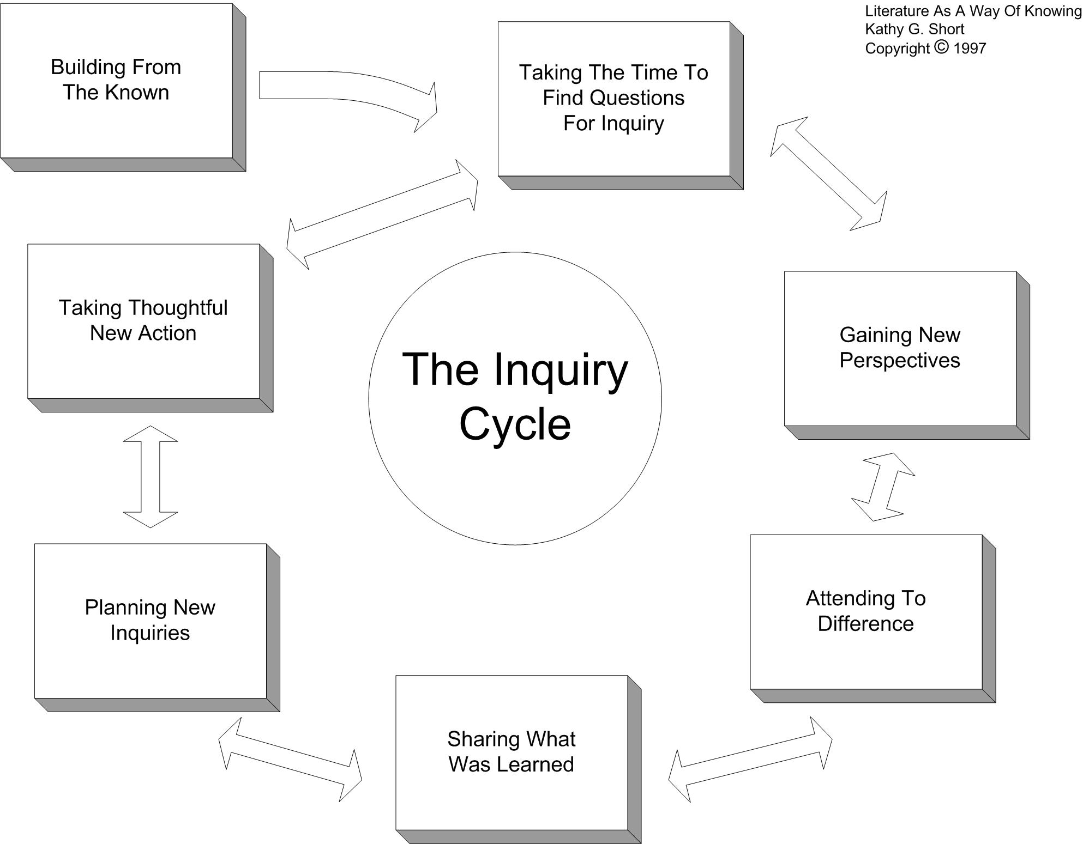
Inquiry Cycle

Slide 48
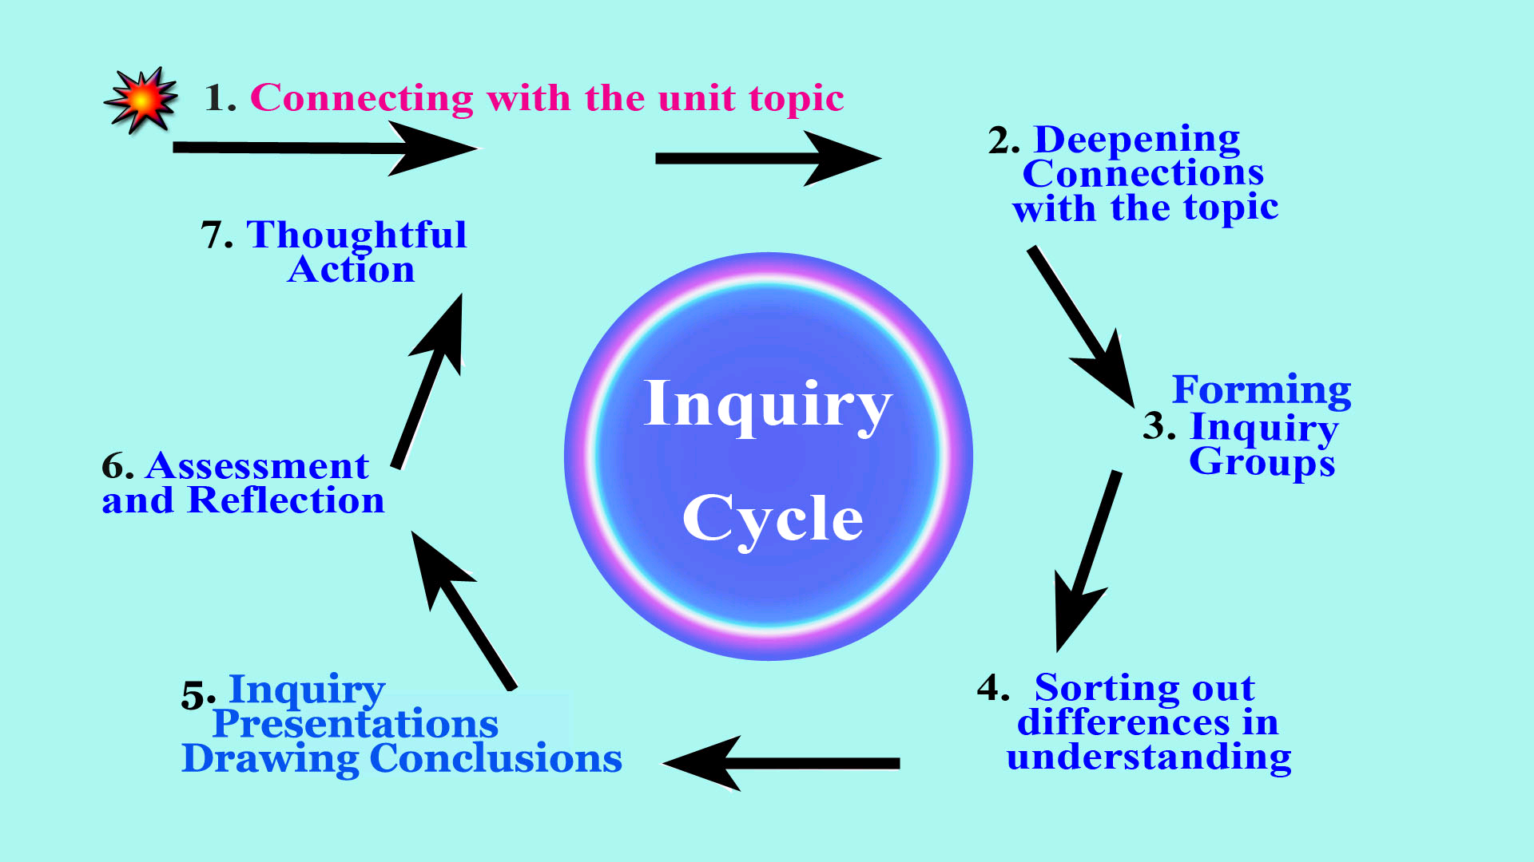
Inquiry Cycle from http://www.inquiryschools.org

Slide 49
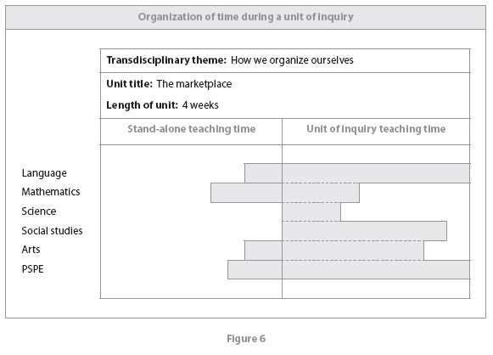
Unit of Inquiry vs. stand alone teaching
The relationship between the subject areas and the units of inquiry will change from one unit to another.
The goal is to “ensure the programme of inquiry remains the definitive experience from the students’ standpoint”.
MIH p14 figure 6

Slide 50
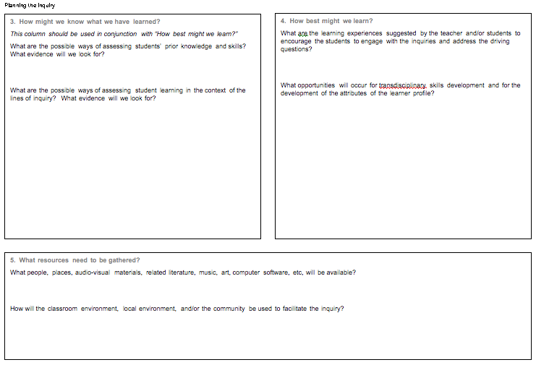
Stages 3 to 5 -Planning the Inquiry
Let’s look at sample planners in your participant workbook on page 49.
Find one for your age range.
Notes:
49

Slide 51
Attitudes
“I show….”
Profile
“I am………”

Slide 52

Transdisciplinary Skills
The definitions of Transdisciplinary Skills are found on p 21 in Making the PYP Happen
  Communication
  Research
  Thinking
  Self-Management
  Social
  Check all the skills that you have used during this workshop.
Notes:
51

Slide 53
Summative Assessment
Add the skills you will measure using this assessment
Notes:
52

Slide 54
Stages 3 to 5 -Planning the Inquiry
Notes:
53

Slide 55
The Action Cycle p26 Read Making the PYP Happen
Reflect
Act
Choose
Notes:
54

Slide 56
Action
Action can be small or large. Simple or grandiose.
Action can be modeled by the teacher, especially in the beginning stages of implementation.
Notes:
55

Slide 57
Notes:
56

Slide 58
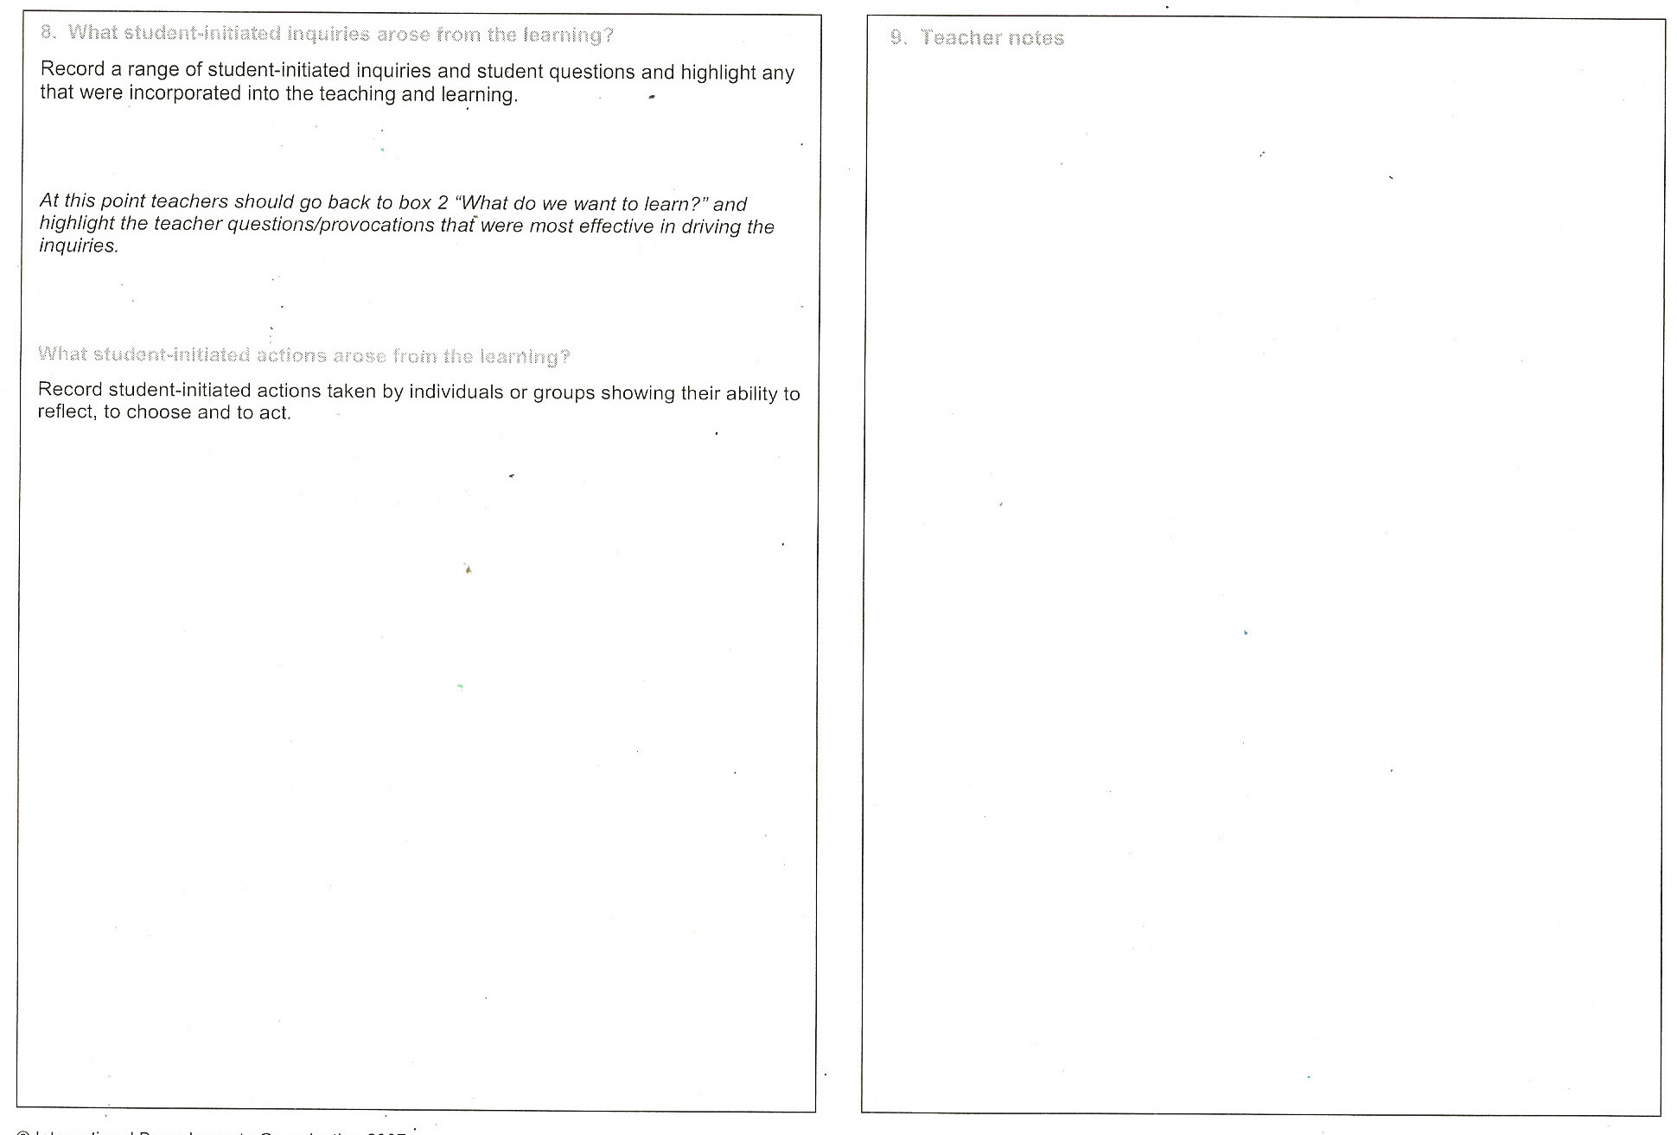
Notes:
57

